Slide 1
Sentiment Analysis
What is Sentiment Analysis?
Thank you Professor Dan Jurafsky

Slide 2
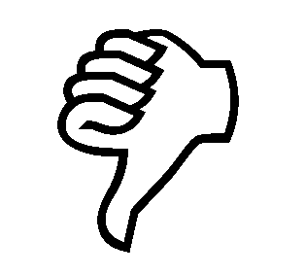

Positive or negative movie review?
unbelievably disappointing
Full of zany characters and richly applied satire, and some great plot twists
this is the greatest screwball comedy ever filmed
It was pathetic. The worst part about it was the boxing scenes.
2

Slide 3
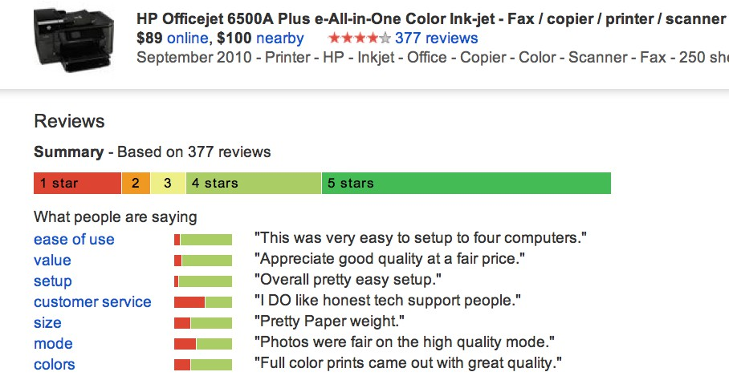
Google Product Search
a
3

Slide 4
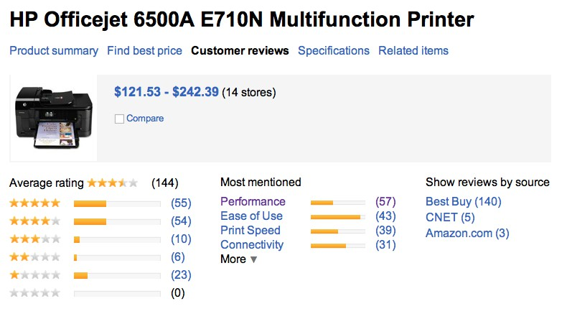
Bing Shopping
a
4

Slide 5
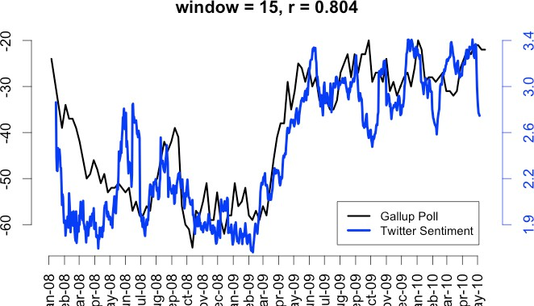
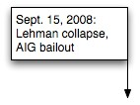
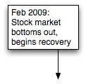
Twitter sentiment versus Gallup Poll of Consumer Confidence
Brendan O'Connor, Ramnath Balasubramanyan, Bryan R. Routledge, and Noah A. Smith. 2010.
From Tweets to Polls: Linking Text Sentiment to Public Opinion Time Series. In ICWSM-­‐2010

Slide 6
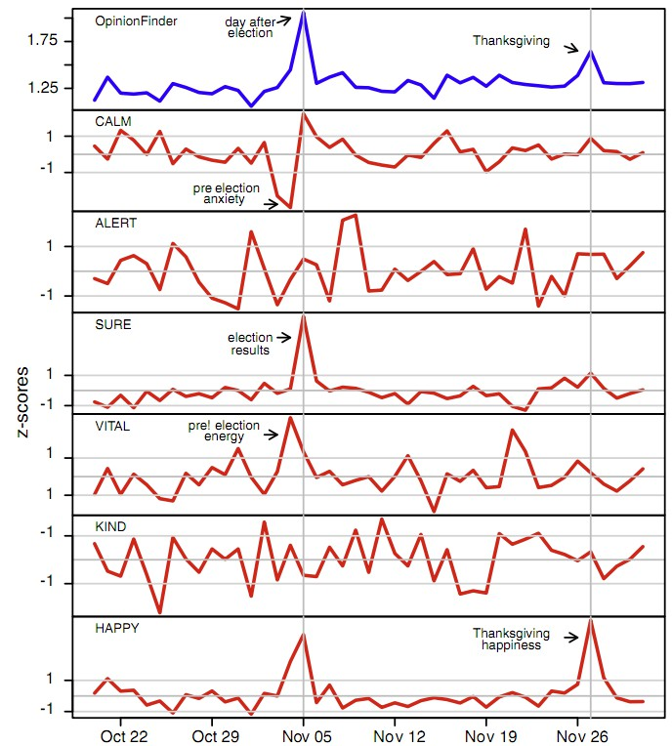
Twitter sentiment:
Johan Bollen, Huina Mao, Xiaojun Zeng. 2011.
Twitter mood predicts the stock market,
Journal of Computational Science 2:1, 1-­‐8. 10.1016/j.jocs.2010.12.007.
6

Slide 7
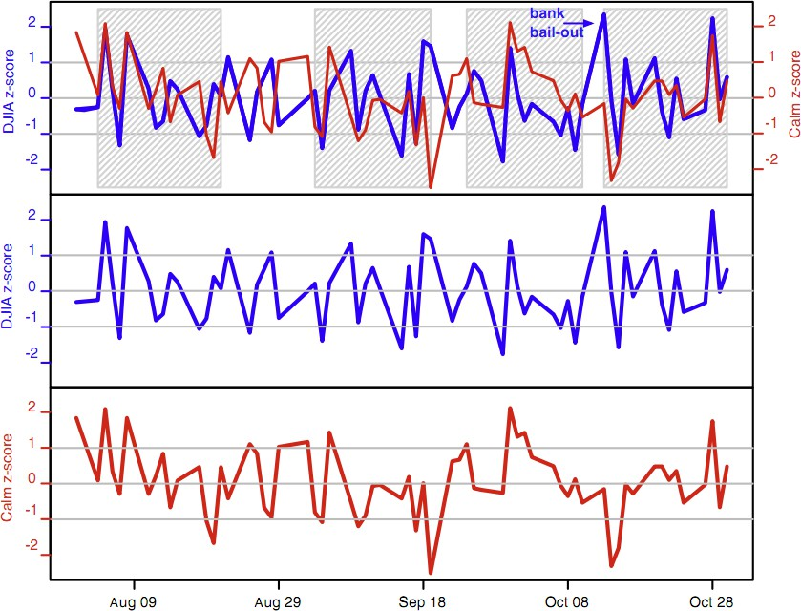
Bollen et al. (2011)
CALM predicts DJIA 3 days later
At least one current hedge fund uses this algorithm
Dow Jones
CALM
7

Slide 8
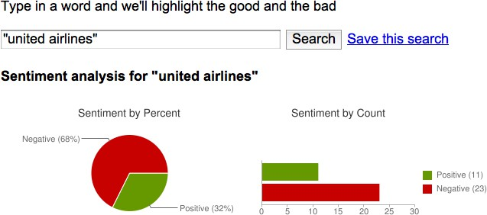
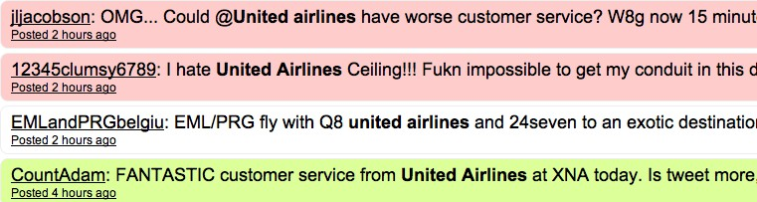
Target Sentiment on Twitter
Twitter Sentiment App
Alec Go, Richa Bhayani, Lei Huang. 2009. Twitter Sentiment Classification using Distant Supervision
8

Slide 9
Sentiment analysis has many other names
Opinion extraction
Opinion mining
Sentiment mining
Subjectivity analysis
9

Slide 10
Why sentiment analysis?
Movie: is this review positive or negative?
Products: what do people think about the new iPhone?
Public sentiment: how is consumer confidence? Is despair increasing?
Politics: what do people think about this candidate or issue?
Prediction: predict election outcomes or market trends from sentiment
10

Slide 11
Scherer Typology of Affective States
Emotion: brief organically synchronized … evaluation of a major event
angry, sad, joyful, fearful, ashamed, proud, elated
Mood: diffuse non-­‐caused low-­‐intensity long-­‐duration change in subjective feeling
cheerful, gloomy, irritable, listless, depressed, buoyant
Interpersonal stances: affective stance toward another person in a specific interaction
friendly, flirtatious, distant, cold, warm, supportive, contemptuous
Attitudes: enduring, affectively colored beliefs, dispositions towards objects or persons
liking, loving, hating, valuing, desiring
Personality traits: stable personality dispositions and typical behavior tendencies
nervous, anxious, reckless, morose, hostile, jealous

Slide 12
Scherer Typology of Affective States
Emotion: brief organically synchronized … evaluation of a major event
angry, sad, joyful, fearful, ashamed, proud, elated
Mood: diffuse non-­‐caused low-­‐intensity long-­‐duration change in subjective feeling
cheerful, gloomy, irritable, listless, depressed, buoyant
Interpersonal stances: affective stance toward another person in a specific interaction
friendly, flirtatious, distant, cold, warm, supportive, contemptuous
Attitudes: enduring, affectively colored beliefs, dispositions towards objects or persons
liking, loving, hating, valuing, desiring
Personality traits: stable personality dispositions and typical behavior tendencies
nervous, anxious, reckless, morose, hostile, jealous

Slide 13
Sentiment Analysis
Sentiment analysis is the detection of attitudes
“enduring, affectively colored beliefs, dispositions towards objects or persons”
Holder (source) of attitude
Target (aspect) of attitude
Type of attitude
From a set of types
Like, love, hate, value, desire, etc.
Or (more commonly) simple weighted polarity:
positive, negative, neutral, together with strength
Text containing the attitude
Sentence or entire document
13

Slide 14
Sentiment Analysis
Simplest task:
Is the attitude of this text positive or negative?
More complex:
Rank the attitude of this text from 1 to 5
Advanced:
Detect the target, source, or complex attitude types

Slide 15
Sentiment Analysis
Simplest task:
Is the attitude of this text positive or negative?
More complex:
Rank the attitude of this text from 1 to 5
Advanced:
Detect the target, source, or complex attitude types

Slide 16
Sentiment Analysis
What is Sentiment Analysis?

Slide 17
Sentiment Analysis
A Baseline Algorithm

Slide 18
Sentiment Classification in Movie Reviews
Bo Pang, Lillian Lee, and Shivakumar Vaithyanathan. 2002. Thumbs up? Sentiment Classification using Machine Learning Techniques. EMNLP-­‐2002, 79—86.
Bo Pang and Lillian Lee. 2004. A Sentimental Education: Sentiment Analysis Using Subjectivity Summarization Based on Minimum Cuts. ACL, 271-­‐278
Polarity detection:
Is an IMDB movie review positive or negative?
Data: Polarity Data 2.0:
http://www.cs.cornell.edu/people/pabo/movie-­‐review-­‐data

Slide 19
IMDB data in the Pang and Lee database
✗
“ snake eyes ” is the most aggravating kind of movie : the kind that shows so much potential then becomes unbelievably disappointing .
it’s not just because this is a brian depalma film , and since he’s a great director and one who’s films are always greeted with at least some fanfare .
and it’s not even because this was a film starring nicolas cage and since he gives a brauvara performance , this film is hardly worth his talents .
✓
when _star wars_ came out some twenty years ago , the image of traveling throughout the stars has become a commonplace image . […]
when han solo goes light speed , the stars change to bright lines , going towards the viewer in lines that converge at an invisible point .
cool .
_october sky_ offers a much simpler image–that of a single white dot , traveling horizontally across the night sky . [. . . ]

Slide 20
Baseline Algorithm (adapted from Pang and Lee)
Tokenization
Feature Extraction
Classification using different classifiers
Naïve Bayes
MaxEnt
SVM

Slide 21
Sentiment Tokenization Issues
Deal with HTML and XML markup
Twitter mark-­‐up (names, hash tags)
Capitalization (preserve for
Potts emoticons
words in all caps)
Phone numbers, dates
Emoticons
Useful code:
[<>]?
[:;=8]
[\-o\*\']? [\)\]\(\[dDpP/\:\}\{@\|\\]
| [\)\]\(\[dDpP/\:\}\{@\|\\] [\-o\*\']?
[:;=8]
[<>]?
# optional # eyes
# optional # mouth
hat/brow
nose
####
reverse orientation
# mouth
# optional # eyes
# optional
nose
hat/brow
Christopher Potts sentiment tokenizer
Brendan O’Connor twitter tokenizer
21

Slide 22
Extracting Features for Sentiment Classification
How to handle negation
I | didn’t | like | this | movie
vs I | really | like | this | movie
Which words to use?
Only adjectives
All words
All words turns out to work better, at least on this data
22

Slide 23

Negation
Das, Sanjiv and Mike Chen. 2001. Yahoo! for Amazon: Extracting market sentiment from stock message boards. In Proceedings of the Asia Pacific Finance Association Annual Conference (APFA).
Bo Pang, Lillian Lee, and Shivakumar Vaithyanathan. 2002. Thumbs up? Sentiment Classification using Machine Learning Techniques. EMNLP-2002, 79—86.
Add NOT_ to every word between negation and following punctuation:
didn’t like this movie , but I
didn’t NOT_like NOT_this NOT_movie but I

Slide 24
∏
Reminder: Naïve Bayes
c_{NB} = argmax P(c_{j} )
P(w_{i} | c_{j} )
c_{j}∈C
i∈ positions
_{Pˆ(w | c) =} count(w, c) +1
count(c) + V
24

Slide 25
Binarized (Boolean feature) Multinomial Naïve Bayes
Intuition:
For sentiment (and probably for other text classification domains)
Word occurrence may matter more than word frequency
The occurrence of the word fantastic tells us a lot
The fact that it occurs 5 times may not tell us much more.
Boolean Multinomial Naïve Bayes
Clips all the word counts in each document at 1
25

Slide 26
Boolean Multinomial Naïve Bayes: Learning
From training corpus, extract Vocabulary
Calculate P(c_{j}) terms
Calculate P(w_{k} | c_{j}) terms
•• TReexmt_{j}o←ve dsiunpglilceadteoscincoeancthaidnoinc:g all docs_{j}
Fo• r^{F}eºa^{r}c^{e}hªw^{ch}o^{w}rd^{or}w^{d}_{k}^{ty}in^{pe}V^{w}oc^{i}a^{n}b^{d}uºl^{c}ajry
For each c_{j} in C do
docs_{j} ← all docs with class =c_{j}
_{n}• ←Re#ta_{o}in_{f} o_{o}n_{c}l_{c}y_{u}a_{r}s_{r}i_{e}n_{n}g_{c}le_{e}i_{s}n_{o}st_{f}a_{w}nce_{in}of_{T}w_{ext}
| docs_{j} |
k
k
n_{k} + α
j
P(c_{j} ) ←
| total # documents|
P(w_{k} | c_{j} ) ←
n + α | Vocabulary |

Slide 27
Boolean Multinomial Naïve Bayes on a test document d
First remove all duplicate words from d
Then compute NB using the same equation:
∏
c_{NB} = argmax P(c_{j} )
P(w_{i} | c_{j} )
c_{j}∈C
i∈ positions
27

Slide 28
Normal vs. Boolean Multinomial NB
Normal | Doc | Words | Class
Training | 1 | Chinese Beijing Chinese | c
 | 2 | Chinese Chinese Shanghai | c
 | 3 | Chinese Macao | c
 | 4 | Tokyo Japan Chinese | j
Test | 5 | Chinese Chinese Chinese Tokyo Japan | ?
Boolean | Doc | Words | Class
Training | 1 | Chinese Beijing | c
 | 2 | Chinese Shanghai | c
 | 3 | Chinese Macao | c
 | 4 | Tokyo Japan Chinese | j
Test | 5 | Chinese Tokyo Japan | ?
28

Slide 29
Binarized (Boolean feature) Multinomial Naïve Bayes
B. Pang, L. Lee, and S. Vaithyanathan. 2002. Thumbs up? Sentiment Classification using Machine Learning Techniques. EMNLP-­‐2002, 79—86.
V. Metsis, I. Androutsopoulos, G. Paliouras. 2006. Spam Filtering with Naive Bayes – Which Naive Bayes? CEAS 2006 -­‐ Third Conference on Email and Anti-­‐Spam.
K.-­‐M. Schneider. 2004. On word frequency information and negative evidence in Naive Bayes text classification. ICANLP, 474-­‐485.
JD Rennie, L Shih, J Teevan. 2003. Tackling the poor assumptions of naive bayes text classifiers. ICML 2003
Binary seems to work better than full word counts
This is not the same as Multivariate Bernoulli Naïve Bayes
MBNB doesn’t work well for sentiment or other text tasks
Other possibility: log(freq(w))
29

Slide 30
Cross-­‐Validation
Iteration
Test
Training
Break up data into 10 folds
(Equal positive and negative inside each fold?)
For each fold
Choose the fold as a temporary test set
Train on 9 folds, compute performance on the test fold
Report average performance of the 10 runs
1
 | Test | Training
2
Training | Test | Training
3
Training | Test
4
Training
Test
5

Slide 31
Other issues in Classification
MaxEnt and SVM tend to do better than Naïve Bayes
31

Slide 32
Problems:
What makes reviews hard to classify?
Subtlety:
Perfume review in Perfumes: the Guide:
“If you are reading this because it is your darling fragrance, please wear it at home exclusively, and tape the windows shut.”
Dorothy Parker on Katherine Hepburn
“She runs the gamut of emotions from A to B”
32

Slide 33
Thwarted Expectations and Ordering Effects
“This film should be brilliant. It sounds like a great plot, the actors are first grade, and the supporting cast is good as well, and Stallone is attempting to deliver a good performance. However, it can’t hold up.”
Well as usual Keanu Reeves is nothing special, but surprisingly, the very talented Laurence Fishbourne is not so good either, I was surprised.
33

Slide 34
Sentiment Analysis
A Baseline Algorithm

